Slide 1


UNIT 5: Me and the World
The world of animals

Slide 2
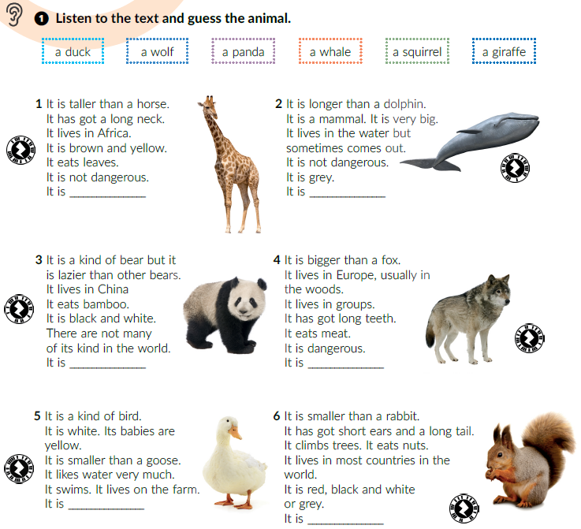


What do these words mean?
mammal =
dangerous =
nuts =
tail =
Click on the following link and choose Learn more: Animals. Look at the photos and name the animals.
https://www.e-sfera.hr/dodatni-digitalni-sadrzaji/eebc6b14-6849-4d18-be0b-e9f23794c283/
sisavac
opasan
lješnjaci
rep
giraffe
whale
Textbook, p. 90
Listen and write the correct word on the line.
Which animal do you like best? Read the text about it out loud.
Close your book and say five important information about that animal.
panda
wolf
duck
squirrel

Slide 3
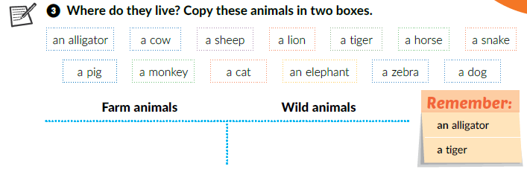
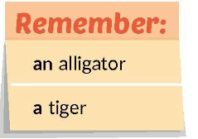
Click on the following link and choose Learn more: Animals.
Use your book (page 91, task 3) and guess the animal.
https://www.e-sfera.hr/dodatni-digitalni-sadrzaji/eebc6b14-6849-4d18-be0b-e9f23794c283/
Sort out the words.
a cow, a sheep, a horse, a pig, a cat, a dog
an alligator, a lion, a tiger, a snake, a monkey, an elephant, a zebra
When do we use a? When do we use an?
a + consonant (b, c, d…)
an + vowel (a, e, i, o, u)

Slide 4
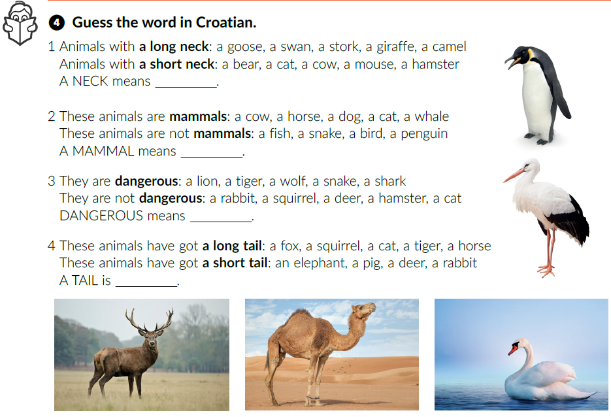
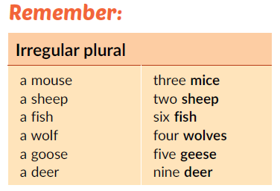
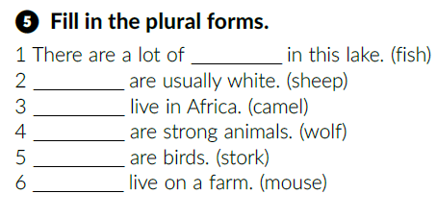
vrat
sisavac
opasan
rep
fish
Sheep
Camels
Wolves
Storks
Mice

Slide 5
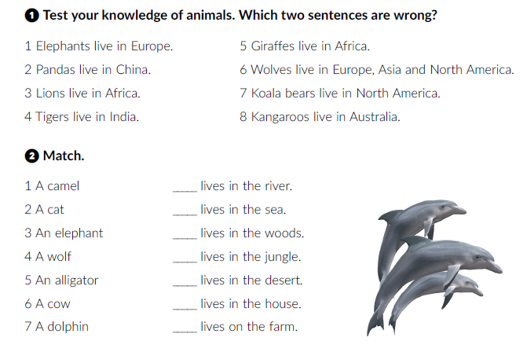
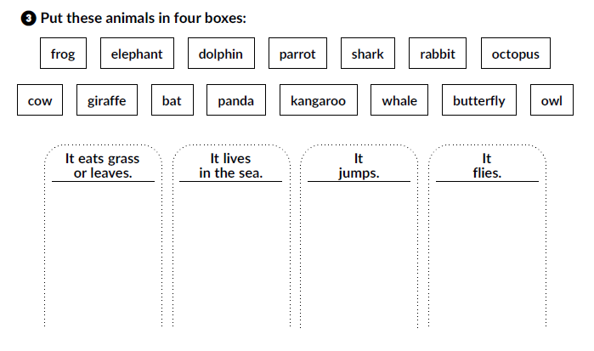
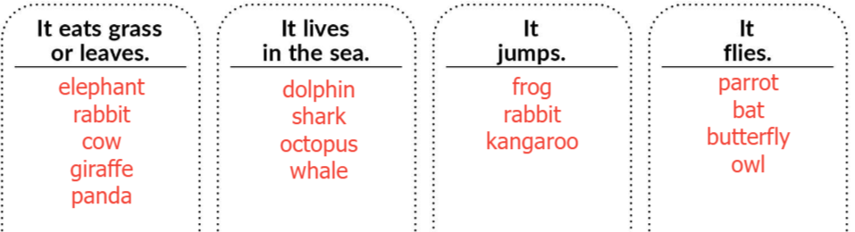
Click on the following link and choose Self check. Complete the tasks.
https://www.e-sfera.hr/dodatni-digitalni-sadrzaji/eebc6b14-6849-4d18-be0b-e9f23794c283/
Workbook, p.62-63.
Africa.
Australia.
5
7
4
3
1
2
6

Slide 6
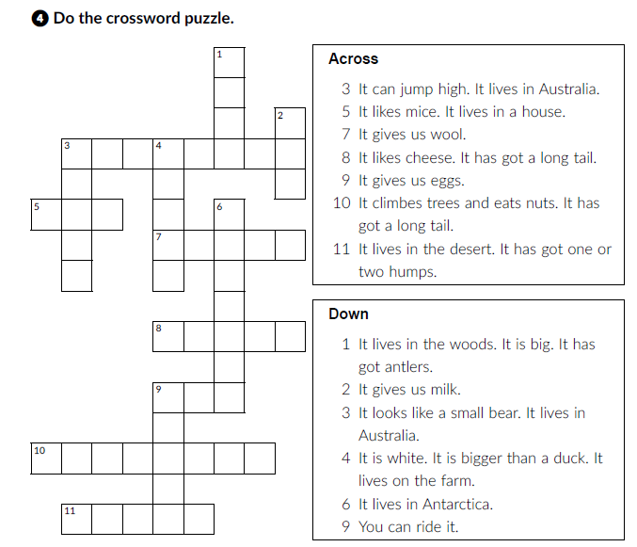
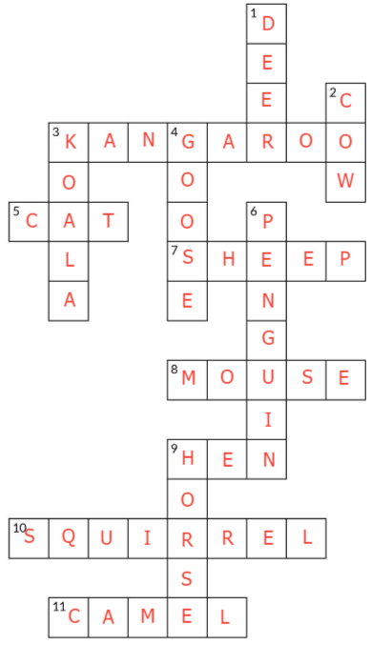
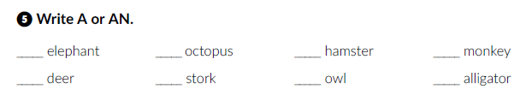
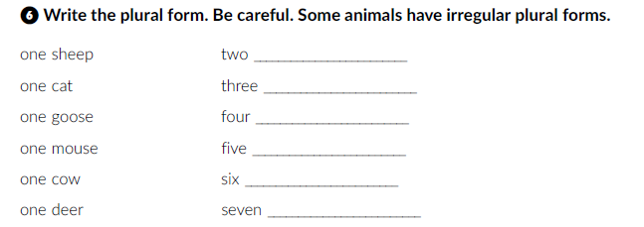

an
an
a
a
a
a
an
an
sheep
cats
geese
mice
cows
deer
horses
wolves
bears

Slide 7
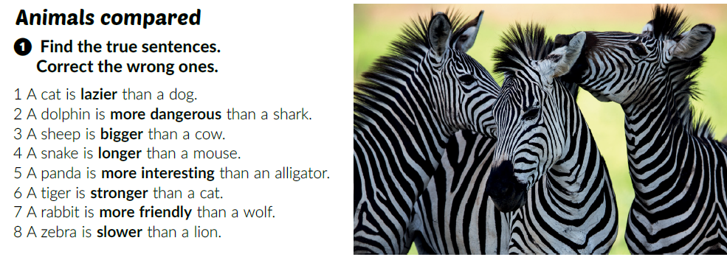
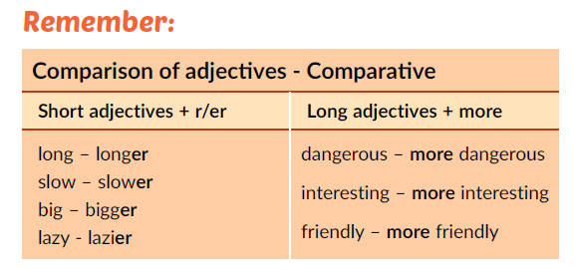
Textbook, p. 92.
2 A shark is more dangerous than a dolphin.
3 A cow is bigger than a sheep.
What type of words are the words in bold?
Name a few adjectives.
Adjectives.
Click on the following link and open the PowerPoint Comparison of adjectives and learn more about it.
https://www.e-sfera.hr/udzbenicke-serije/podrska/daf7bd10-1bcb-47bf-948c-893bad7d56d3

Slide 8
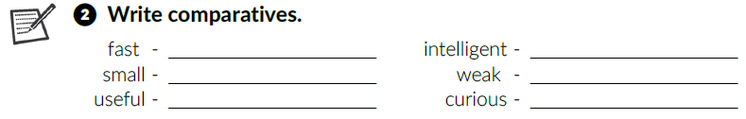
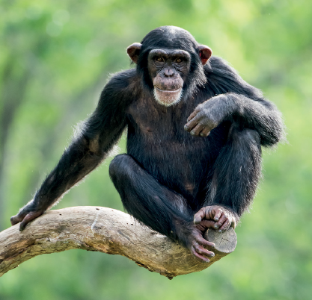
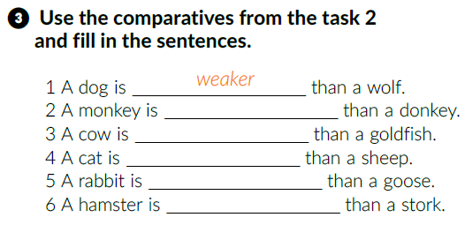
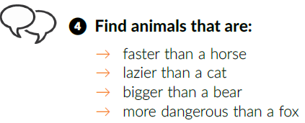
faster
more intelligent
smaller
weaker
more useful
more curious
more intelligent
more useful
more curious
faster
smaller

Slide 9
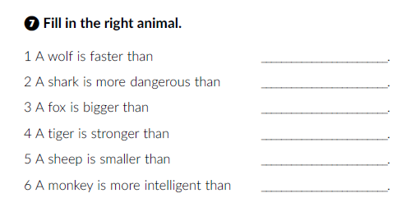
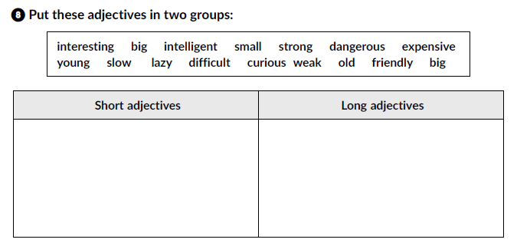
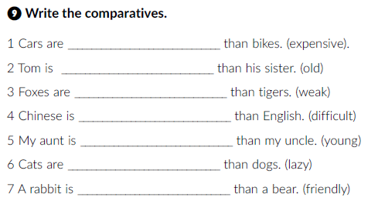
Click on the following links and complete the tasks.
https://learningapps.org/watch?v=pc0p3p4e218
https://learningapps.org/watch?v=p99t15uk518
Workbook, p. 64
big, lazy, slow, old, strong, small, weak, young, friendly
interesting, intelligent, dangerous, expensive, difficult, curious
more expensive
older
weaker
more difficult
younger
lazier
friendlier

Slide 10
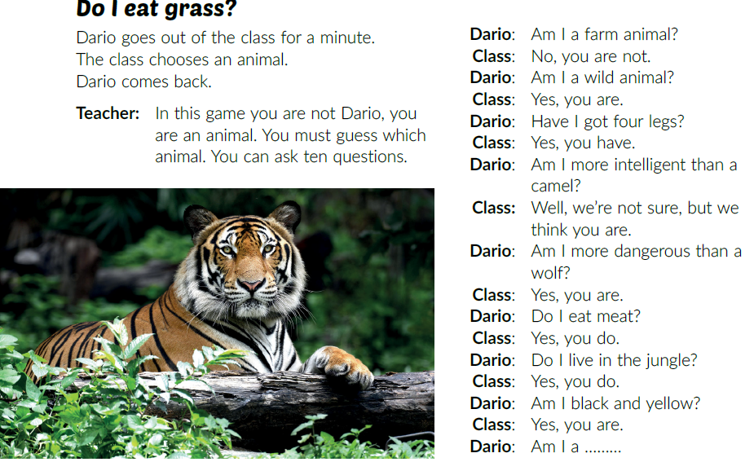
Click on the following link and choose Self check. Complete the tasks.
https://www.e-sfera.hr/dodatni-digitalni-sadrzaji/398a2ec1-490a-4044-8e25-3733901422d8/
Listen and mime the animal you hear.
tiger
camel
deer
fox
lion
bear
Textbook, p. 93.
Listen and explain the rules of the game to
your classmates.
Play the guessing game in class.

Slide 11
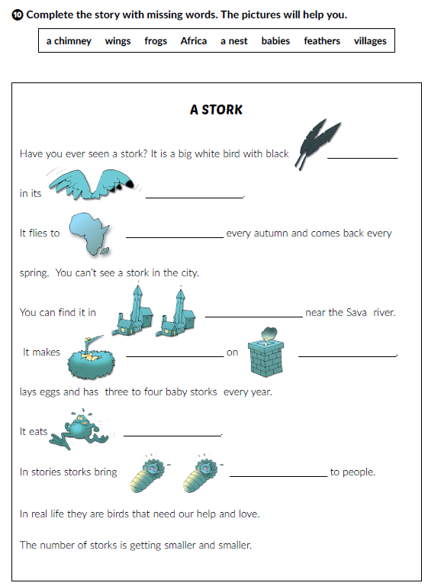
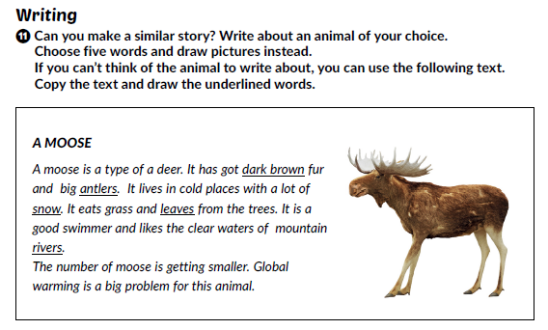

Workbook, p. 65-66.
feathers
wings
Africa
villages
a nest
a chimney
frogs
babies

Slide 12
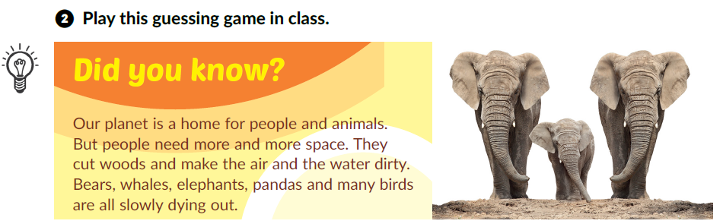
Textbook, p. 92.
Translate:
ecology =
endangered species =
ekologija
ugrožena vrsta
Can you name some endangered animals?
Click on the following link and choose Learn more: Endangered animals.
https://www.e-sfera.hr/dodatni-digitalni-sadrzaji/eebc6b14-6849-4d18-be0b-e9f23794c283/
Read the text again. Why are they special?

Slide 13
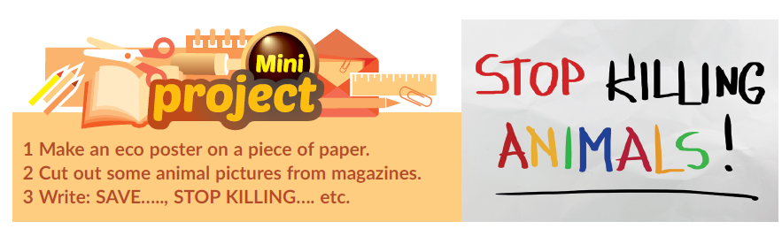
Why are some animals endangered?
What can we do to save them?
Project time!

